Slide 1
A Study Of
The Book Of Revelation
December 6, 2020

Slide 2

Revelation 10
Revelation 10:7
“but in the days of the voice of the seventh angel, when he is about to sound, then is finished the mystery of God, according to the good tidings which he declared to his servants the prophets.”

Slide 3
Revelation 10
Revelation 10:7
The prophets prophesied of God’s plan of redemption. However, it is no longer a mystery because it has been revealed (Romans 16:25-26; Ephesians 3:3-7).
Daniel prophesied that His kingdom would be established in the days of the fourth kingdom – the Roman Empire (Daniel 2:40, 44-45).
  This was fulfilled when Christ arose from the grave and ascended to the right hand of God (Mark 1:14-15; 9:1;
  Daniel 7:13-14; Ephesians 1:20-23; Acts 2:30, 33-36; Galatians 4:4).
  God’s kingdom would be unlike earthly nations which inevitably rise and fall. God’s kingdom is spiritual, and it shall stand forever (John 18:36; Daniel 2:44).

Slide 4
Revelation 10
Revelation 10:7
The prophets foretold of the “destruction of Jerusalem” by the Romans!
  This is found in Daniel 9:24-27 – abomination that maketh desolate! (cf. Matthew 24:15; Luke 21:20-24)
  The “one that maketh desolate” shall also be punished afterward (verse 27).
The prophets also foretold in “visions and prophecies” that Rome would also be destroyed.
  The “mystery” would be completed when the “end” came.
    The end of what?
  Daniel 7:15-28

Slide 5
Revelation 10
Revelation 10:7
Daniel 7
Daniel also foretold how God’s kingdom would be opposed by this fourth empire (Daniel 7:15-28).
The Roman Empire, led by wicked rulers both in Rome and the chief provinces, would make war with the saints, but it would not prevail.
Instead, “But the saints of the Most High shall receive the kingdom, and possess the kingdom for ever, even for ever and ever.” (Daniel 7:18; cf. Daniel 7:22-27).
Revelation discloses the fulfillment of this prophecy and explains how this mystery of God should be finished.

Slide 6
Revelation 10
Revelation 10:7
Compare the figures pictured in Daniel 7 and those found in John’s Revelation.
“(1) Much of the same symbolism is employed to describe both
empires. The term ‘beast’ is used for the empire and its leader in
both works (cf. Daniel 7:7, 11, 19, 23; Revelation 13:1-2, etc.; 17:3, etc.).
“(2) Both kingdoms are opposed to God, and their leader blasphemes his name. This applies in both Daniel and in the Revelation equally (cf. Daniel 7:25; Revelation 13:1, 5-6).
“(3) Both beasts are said to have ten horns. Again, these exact characterizations of the beasts appear in almost the identical words in Daniel’s vision and in the visions of John (cf. Daniel 7:7, 20, 24; Revelation 13:1; 17:3, 12, 16).”
(Daniel H. King, Sr., The Book of Daniel, Truth Commentaries, Page 497)

Slide 7
Revelation 10
Revelation 10:7
Compare the figures pictured in Daniel 7 and those found in John’s Revelation.
“(4) Both empires persecute the saints. While persecution of the saints is a minor feature in Daniel, it is the major emphasis and a continuous theme of the book of Revelation. (cf. Daniel 7:25;
Revelation 13:7).
“(5) Both empires are extended great power over the saints for a period of three and one-half years. This selfsame numerical symbol, is a common figure employed in both. (cf. Daniel 7:25; Revelation 11:2-3; 13:5).”
(Daniel H. King, Sr., The Book of Daniel, Truth Commentaries, Page 498)

Slide 8
Revelation 10
Revelation 10:7
Compare the figures pictured in Daniel 7 and those found in John’s Revelation.
“(6) Both empires are brought down by the power of God and God’s kingdom is set forth as an alternative to this worldly dominion. Just as Daniel is comforted with the knowledge that God will finally bring down this wretched instrument of wickedness and his violent worldly kingdom, John also promises the eventual downfall of the cruel and despotic enemy of the church (cf. Daniel 7:26-27; Revelation 19:19-20).”
(Daniel H. King, Sr., The Book of Daniel, Truth Commentaries, Page 498)
The two mysterious figures from Daniel and the Revelation are the same.

Slide 9
The Seventh Angel
Revelation 10
In this day the trumpet will sound.
The “mystery” of God will be finished.
Warnings of the six previous trumpets were enough.
This mystery would involve God’s eternal purpose for His people – ultimate victory.
Judgment of evil and punishment.
Deliverance and vindication of all of God’s people.

Slide 10
Revelation 10
The Seventh Angel
VICTORY:
All of the visions center upon one underlying theme of Revelation neatly summarized in the words of the seventh angel and the great voices in heaven:
“The kingdom of the world is become (the kingdom) of our Lord, and of his Christ: and he shall reign for ever and ever.” (11:15)

Slide 11
Revelation 10
Revelation 10:8
“And the voice which I heard from heaven, (I heard it) again speaking with me, and saying, Go, take the book which is open in the hand of the angel that standeth upon the sea and upon the earth.”

Slide 12
Revelation 10
Revelation 10:9
“And I went unto the angel, saying unto him that he should give me the little book. And he saith unto me, Take it, and eat it up; and it shall make thy belly bitter, but in thy mouth it shall be sweet as honey.”

Slide 13
Revelation 10
Revelation 10:10
“And I took the little book out of the angel's hand, and ate it up; and it was in my mouth sweet as honey: and when I had eaten it, my belly was made bitter.”

Slide 14
Revelation 10
Instructions for John
Picture 2 – “the little book.”
No doubt, the little book’s message coincides with the previous message, but it may contain more details.
Commanded to go and take the book.
He approached the angel who stood on the sea and earth.
Similar to the prophet Ezekiel’s episode
  Ezekiel 2:8-3:3

Slide 15
Revelation 10
Instructions for John
Picture 2 – “the little book”
John took the book from the angel.
He was to have “mastered” its contents.
Sweet in his mouth
  Received the message of God – Psalms 119:103,104 “How sweet are thy words unto my taste! (Yea, sweeter) than honey to my mouth! Through thy precepts I get understanding: therefore I hate every false way.”
Bitter in his stomach
  To deliver the message of God’s word
  For the Christians in John’s day, the persecution would be bitter and difficult.

Slide 16
Revelation 10
Instructions for John
Picture 2 – “the little book.”
John found it to be sweet in his mouth – but bitter in his stomach.
Message of hope was sweetness.
Fearful message of ongoing persecution.
  Men under God’s judgment for rejecting Him.
  Christians suffering at the hand of God’s enemies.
  1 Thessalonians 1:6; 1 Thessalonians 2:2; 1 Thessalonians 2:14-15; 2 Thessalonians 1:4; 2 Timothy 1:8; 2 Timothy 1:12; 2 Timothy 2:9-12; 2 Timothy 3:2-3; 2 Timothy 3:12; 2 Timothy 4:16-17; Hebrews 10:32-34
  Woe on the church from this conflict with Rome.
  But Rome’s destruction is coming …

Slide 17
Revelation 10
Revelation 10:11
“And they say unto me, Thou must prophesy again over many peoples and nations and tongues and kings.”

Slide 18
Revelation 10
John’s Work Continues
This assured John that he would not die on Patmos.
He would return to continue doing the work God had given him.
He must continue to preach God’s message to the world.
  What he had “eaten” he would deliver.
  The crisis would not deter the preaching of hope.

Slide 19
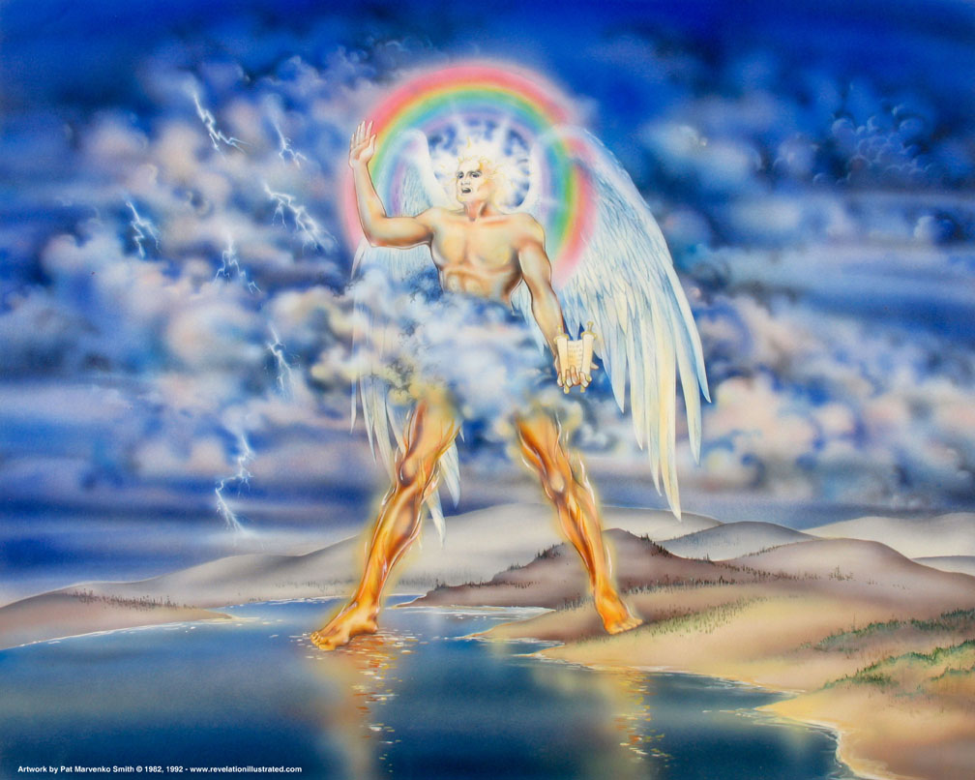
Revelation 10

